Slide 1

University of North Texas – EENG
Final Project
EENG 3910: Project V – DSP System Design
Chris Askings
Ian Hunt
Nathan Ruprecht
A Green Light to Greatness

Slide 2
Overview
Geo Fence
NEO-6M
EDU-MKII
Data Processing
Lessons Learned
Questions
Source Code
A Green Light to Greatness

Slide 3
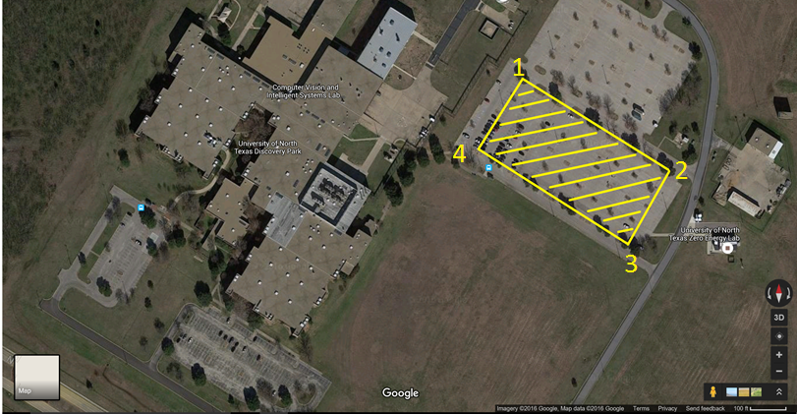
Geo Fence
A Green Light to Greatness

Slide 4

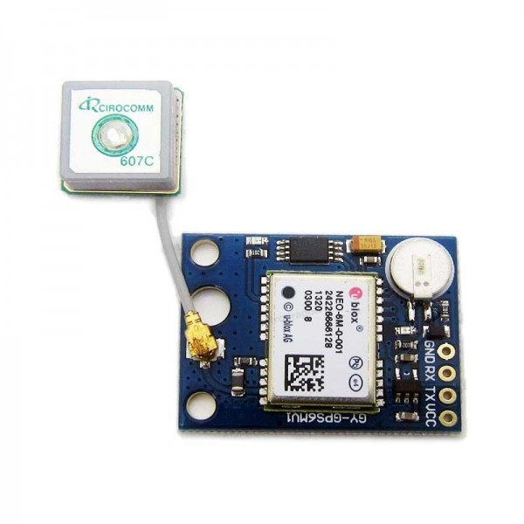
GPS Data Acquisition
UBlox NEO-6MV2 module
GY-GPS6MV1 breakout board
NMEA (National Marine Electronics Association)
$GPGLL frame capture
String parsing
Integer conversion
A Green Light to Greatness

Slide 5
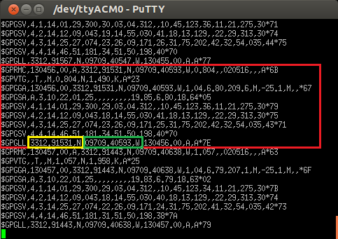
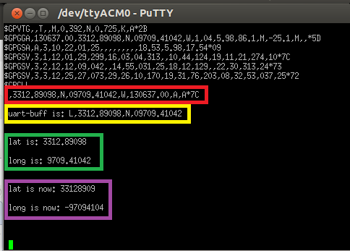
NMEA
A Green Light to Greatness

Slide 6
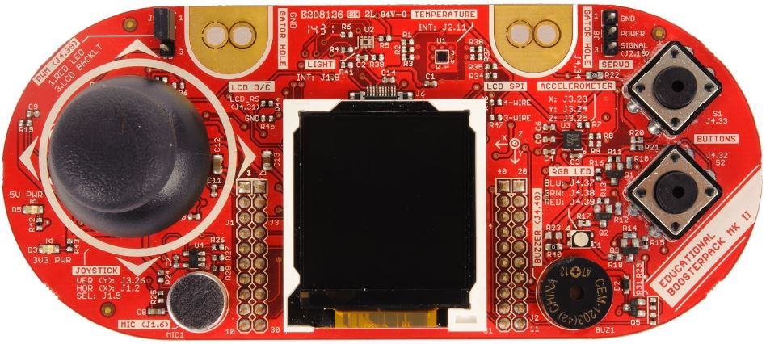
Booster Pack (EDU-MKII)
A matter of finding the pinout when it is plugged into the Tiva Launchpad
MKII Tiva
Blue LED J4.37 PC4
Green J4.38 PB3
Red J4.39 PF3
A Green Light to Greatness

Slide 7
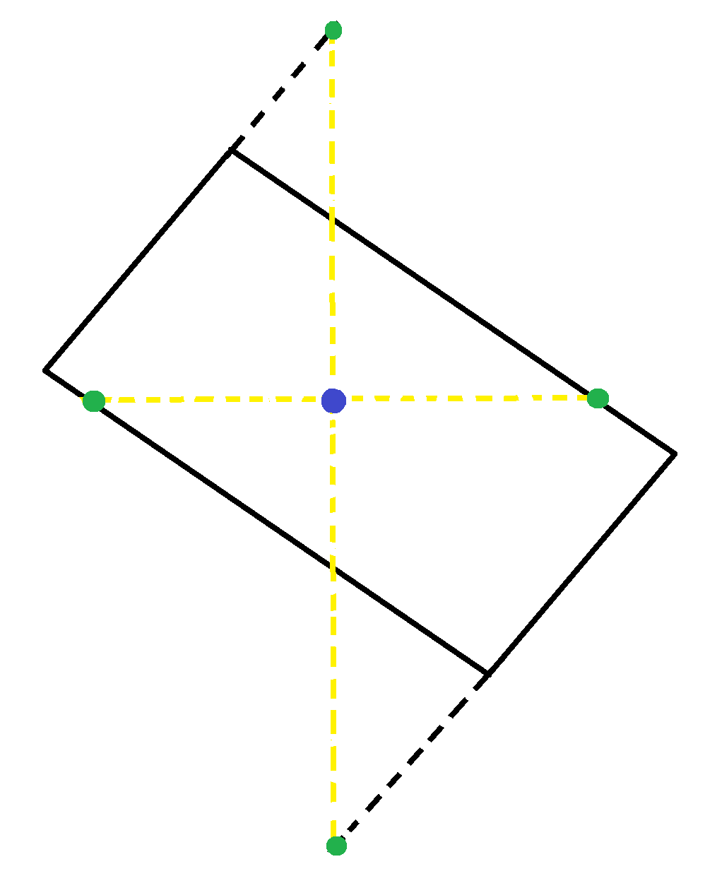
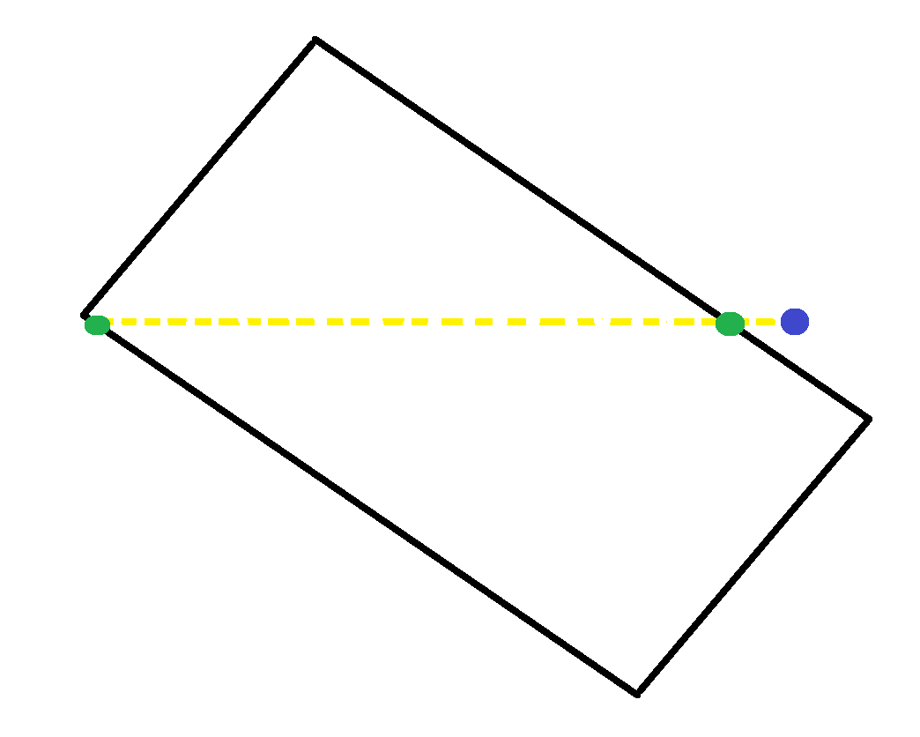
Data Processing
Algebra to compare GPS values to map
A Green Light to Greatness

Slide 8
Lessons Learned
Changes to Proposal
LCD Display
String parsing and conversion is fun!
A Green Light to Greatness

Slide 9
Summary
Geo Fence
NEO-6M
EDU-MKII
Data Processing
Lessons Learned
Questions
Source Code
A Green Light to Greatness

Slide 10

Questions?
A Green Light to Greatness

Slide 11
Source Code – LEDs
void init_LEDs(void)
{
// Red LED
SysCtlPeripheralEnable(SYSCTL_PERIPH_GPIOF);
GPIOPinTypeGPIOOutput(GPIO_PORTF_BASE, GPIO_PIN_3);
// Green LED
SysCtlPeripheralEnable(SYSCTL_PERIPH_GPIOB);
GPIOPinTypeGPIOOutput(GPIO_PORTB_BASE, GPIO_PIN_3);
// Blue LED
SysCtlPeripheralEnable(SYSCTL_PERIPH_GPIOC);
GPIOPinTypeGPIOOutput(GPIO_PORTC_BASE, GPIO_PIN_4);
}//end init_LEDs
if( (GPIOPinRead(GPIO_PORTF_BASE, GPIO_PIN_3)) ||
(GPIOPinRead(GPIO_PORTB_BASE, GPIO_PIN_3)) ||
(GPIOPinRead(GPIO_PORTC_BASE, GPIO_PIN_4)) )
{//All LEDs off
GPIOPinWrite(GPIO_PORTF_BASE, GPIO_PIN_3, 0);
GPIOPinWrite(GPIO_PORTB_BASE, GPIO_PIN_3, 0);
GPIOPinWrite(GPIO_PORTC_BASE, GPIO_PIN_4, 0);
}
else {
switch( cur_LED )
{
case 0://Red
GPIOPinWrite(GPIO_PORTF_BASE, GPIO_PIN_3, 8);
break;
case 1://Green
GPIOPinWrite(GPIO_PORTB_BASE, GPIO_PIN_3, 8);
break;
case 2://Blue
GPIOPinWrite(GPIO_PORTC_BASE, GPIO_PIN_4, 16);
break;
}//End switch
}
A Green Light to Greatness

Slide 12
Source Code – LEDs
condition = check_boundaries(lat_data, long_data);
if( condition ) {
//We're good, green LED
cur_LED=1;
} else {
//We're bad, red LED
cur_LED=0;
}//end if
A Green Light to Greatness

Slide 13
Source Code – Data Processing
int check_boundaries( uint32_t lat_data, uint32_t long_data)
{
uint32_t m12, m41, m43, m32, b12, b41, b43, b32, xcp1, xcp2, ycp1, ycp2;
m12 = (y2-y1) / (x2-x1);
m41 = (y1-y4) / (x1-x4);
m43 = (y3-y4) / (x3-x4);
m32 = (y2-y3) / (x2-x3);
b12 = y1 - m12*x1;
b43 = y4 - m43*x4;
b41 = y4 - m41*x4;
b32 = y3 - m32*x3;
//Take lat_data and find the corresponding y values on the lines from point 1-2
//and point 4-3. These y values are a range.
//Test long_data against those corresponding y values for a vertical check
ycp1 = m12*lat_data + b12;
ycp2 = m43*lat_data + b43;
//Take long_data and find the corresponding x values on the lines from point 4-1
//and point 3-2. These x values are a range.
//Test lat_data against those corresponding x values for a horizontal check
xcp1 = (long_data - b41) / m41;
xcp2 = (long_data - b32) / m32;
if( (long_data <= ycp1) && (long_data >= ycp2) ) { //Check within vertical boundaries
if( (lat_data <= xcp2) && (lat_data >= xcp1) ) { //Check within horizontal boundaries
return 1; //We're inside the fence
}
} else {
return 0; //DEAR GOD WE'RE BAD
}
}//end check_boundaries
A Green Light to Greatness

Slide 14
Source Code – GPS
while(1) {
// Read user inputs from UART if available.
if(UARTRxBytesAvail())
user_cmd = UARTgetc();
else
user_cmd = 0;
switch(user_cmd){
case 'L':
UARTprintf("\n ");
UARTgets(uart_buffer, buffer_length);
UARTprintf("\n uart-buff is: \%s \n \n ", uart_buffer);
data_parse();
break;
}
void data_parse(void)
{
long x;
long y;
x=2;
y=16;
while(x<lat_length){
lat_buffer[x-2]=uart_buffer[x];
long_buffer[y-16]=uart_buffer[y];
x++;
y++;
}
UARTprintf("\n lat is: \%s \n ", lat_buffer);
UARTprintf("\n long is: \%s \n \n ", long_buffer);
lat_to_int();
long_to_int();
}//end data_parse
A Green Light to Greatness

Slide 15
Source Code – GPS
void lat_to_int(void)
{
long i=0, end_dex=9;
char hold;
while(i<end_dex){
hold=lat_buffer[i];
switch(hold){
case '9':
lat_data=lat_data+(9*pow(10,8-i));
//UARTprintf("\n 9lat is now: \%i \n ", lat_data);
break;
case '8':
lat_data=lat_data+(8*pow(10,8-i));
//UARTprintf("\n 8lat is now: \%i \n ", lat_data);
break;
case '.':
lat_data=lat_data/10;
//UARTprintf("\n .lat is now: \%i \n ", lat_data);
break;
}
i++;
}
UARTprintf("\n lat is now: \%i \n ", lat_data);
}//end lat_to_int
A Green Light to Greatness

